Slide 1



International Intestinal Rehabilitation and Transplant Association
A section of the Transplantation Society
International Intestinal
Transplant Registry: 2025 Update
Rob Venick
On Behalf of the IRTA Scientific Committee
Intestinal Transplant Registry Report © 2025

Slide 2

IITR Mission
The International Intestinal Transplant Registry (IITR) collects data on worldwide activity & results of intestinal transplantation (ITx)
Mission: to provide data on ITx outcomes to the international community in order to help improve patient care, and optimize decision making.
Intestinal Transplant Registry Report © 2018
Notes:
Between 1985 and 2016, the database was maintained by the University of Toronto. In 2017, it was transitioned to the Terasaki Research Institute (Los Angeles, CA, www.teras aki.org/itr).

Slide 3
IITR Database Description
Data collection started in 1985
Data collection & analyses are performed by Eric Pahl, with the support of the Scientific Committee of the IIRTA
A simple core data set is collected to promote reporting
Additional data is collected for specific projects
Intestinal Transplant Registry Report © 2018
Notes:
Between 1985 and 2016, the database was maintained by the University of Toronto. In 2017, it was transitioned to the Terasaki Research Institute, in 2020 it was transitioned to Eric Pahl under the direction of the Scientific Committee of the IRTA

Slide 4
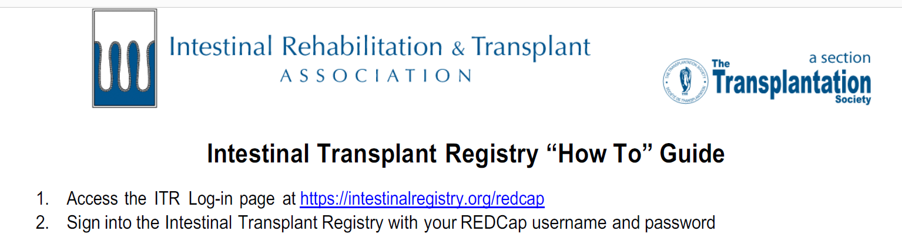
IITR Website
  Data is entered via RedCap
  Center data is confidential and accessible in real time
  Aggregate outcomes are reported in the overall IITR report
Intestinal Transplant Registry Report © 2018

Slide 5

Definitions and Analyses
Definitions:
Transplant Type | Intestine | Liver | Stomach
Small Bowel (SBT)
Liver/SBT
Modified MVT
MVT
Pediatric cases defined as < 18 years.
Intestinal Transplant Registry Report © 2018
Intestinal Transplant Registry Report © 2019
Notes:
SBT for isolated intestine without liver or stomach; Liver plus SBT for intestine and liver without stomach; MVT; Modified MVT for intestine and stomach without liver; and Full MVT for intestine,
stomach, and liver.

Slide 6
2023-2025 IITR Updates
Since last report (CIIRTA June 2023)
  234 new transplants added to IITR
    Including 139 from USA OPTN/SRTR import 3/2025
IITR data was accessed 9/12/2025 for this report
Notes:
Terasaki Research Institute/IRTA performed SRTR data import into ITR in 2019
ITR data entry over the past 3 years as been challenging

Slide 7
Global Intestinal Tx Experience
January 1985 - September 2025
 | Total | Pediatric | Adult
ITx (n=) | 5,507 | 2,692 | 2,815
Reporting Centers | 98 | 76 | 82
Since last report at CIIRTA 2023:
  26 international centers are actively entering data, including 17 pediatric centers
Intestinal Transplant Registry Report © 2018
Notes:
In the 2023 IITR we had 98 reporting centers; how does this decrease
Also previously we had 50 active centers, now it is down to 26???
The # of actively followed patients previously was reported as 2,121 total (1001 children and 1120 adults; the report which Eric sent states 382 actively followed including 187 kids and 195 adults
Nearly 100 centers have reported data to the ITR since 1985

Slide 8
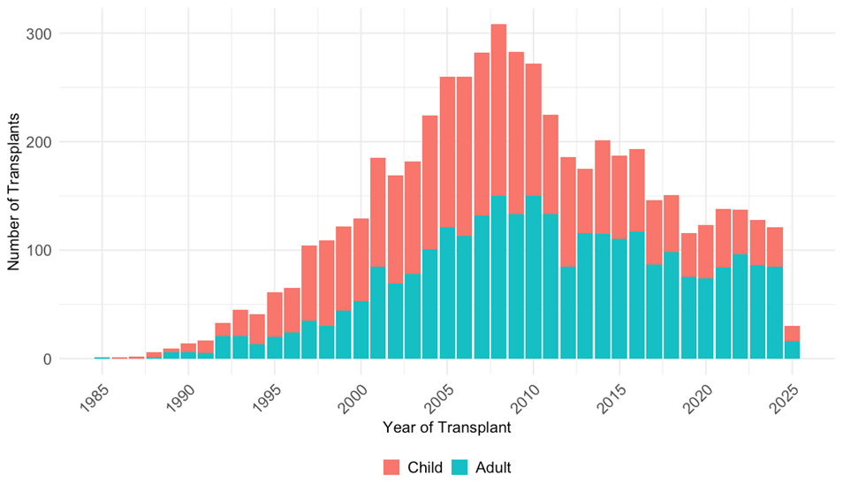
Intestinal Transplants Performed
(All recipients transplanted between Jan 1985- September 2025)
Intestinal Transplant Registry Report © 2018
Notes:
Two observations from this graph:
The number of transplants performed peaked in 2008, declined over the subsequent several years, and has now seemed to stabilize over the past decade
# of ITx has steadily declined over time from over 250/year to 125-175/yr where it appears to have plateaued; this is likely the effect of improvements in intestinal rehabilitation associated with the IRPs, an emphasis on line care/prevention of CLABSIs and wide spread use of FO based lipid emulsions and lipid minimization
The above mentioned practice patterns apply more to children than adults, meaning tha tthe proportion of pediatric ITx has declined; while adult ITx has stayed relative constant, meaning that adult ITx now make up > 50% of the cases worldwide

Slide 9
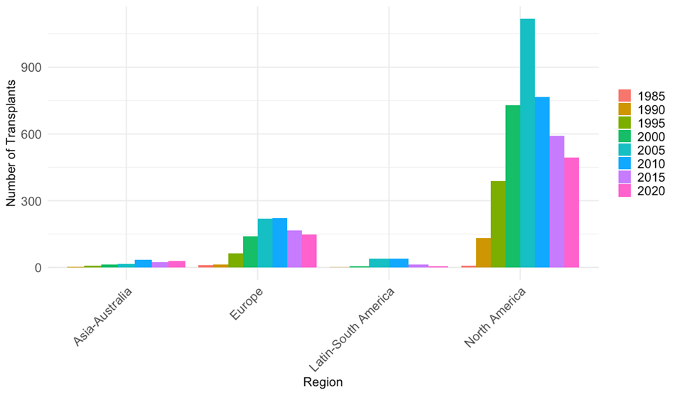
Global Trends In Clinical Activity
Intestinal Transplant Registry Report © 2018
Notes:
¾ performed in N America

Slide 10
Graft Type
Type of Transplant | Pediatric (n=2,692) | Adult (n=2,815) | Overall (n=5,507)
SBT | 29% | 49% | 39%
Liver/SBT | 38% | 11% | 24%
Modified MVT | 2% | 8% | 5%
MVT | 19% | 21% | 20%
The type of transplants have remained proportionally relatively constant over time
Intestinal Transplant Registry Report © 2018
Notes:
49% of adults received isolated bowel vs 2/3 of children received a liver inclusive graft
50% of patients overall received liver inclusive grafts (liver/sbt) or (MVT)
The proportion of the distribution of type of transplant has remained relatively constant

Slide 11
Graft Type
Type of Transplant | Pediatric (n=2,652) | Adult (n=2,789) | Overall (n=5,441)
SBT | 29% | 49% | 39%
Liver/SBT | 38% | 11% | 24%
Modified MVT | 2% | 8% | 5%
MVT | 19% | 21% | 20%
The type of transplants have remained proportionally relatively constant over time
Intestinal Transplant Registry Report © 2018
Notes:
49% of adults received isolated bowel vs 2/3 of children received a liver inclusive graft
50% of patients overall received liver inclusive grafts (liver/sbt) or (MVT)
The proportion of the distribution of type of transplant has remained relatively constant

Slide 12
Demographics of ITx
 | Pediatric | Adult
Median Age at ITx | 2.8 y/o (1.1, 6.9) | 41 y/o (30, 52)
Female | 43% | 51%
Intestinal Transplant Registry Report © 2018

Slide 13
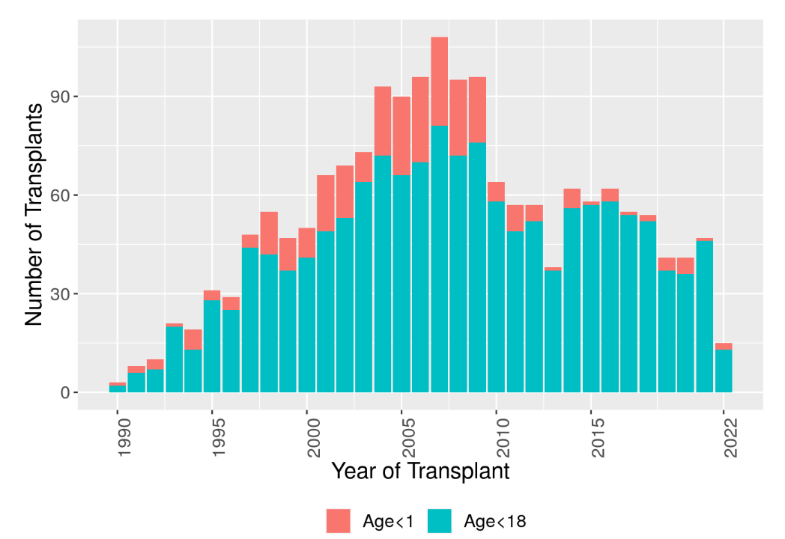
Age at Time of ITx (Peds)
Intestinal Transplant Registry Report © 2018

Slide 14
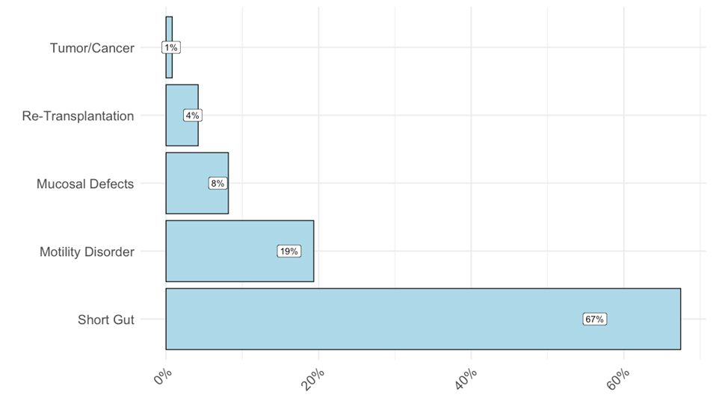
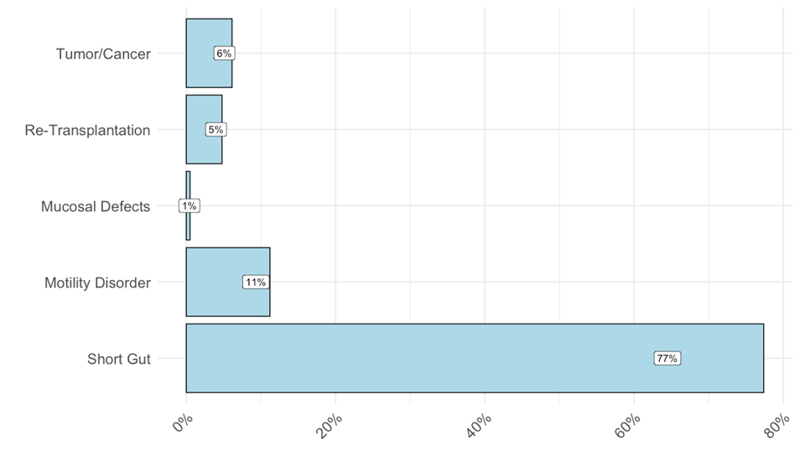
Indications for ITx
Leading causes of peds SBS:
Gastroschisis
Volvulus
NEC
Intestinal atresia
Leading causes of adult SBS:
Ischemia
Crohn’s disease
Volvulus
Trauma
Intestinal Transplant Registry Report © 2018

Slide 15
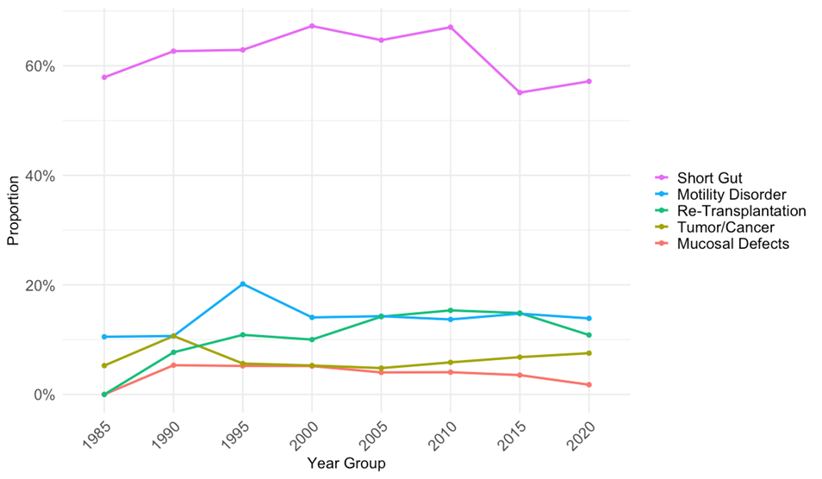
Indications for Transplant Over Time

Slide 16
Trends In Graft Type
Intestinal Transplant Registry Report © 2018

Slide 17
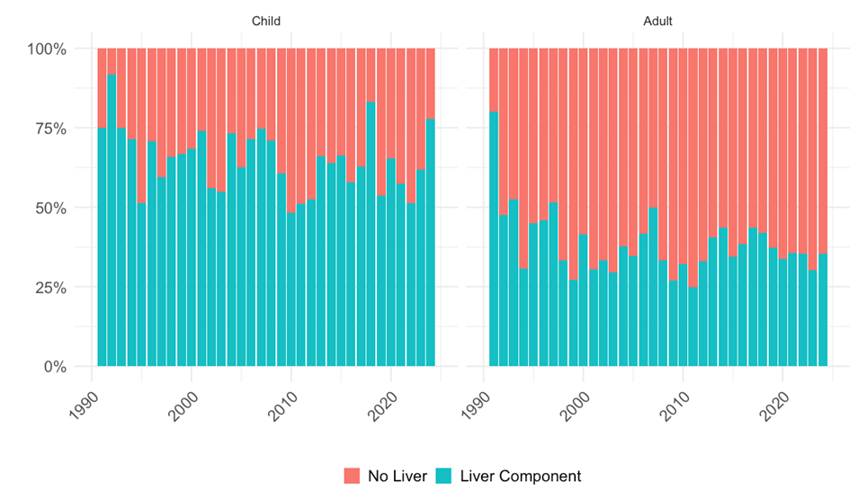

Transplant Type Over Time
Pediatric, n=2652
Adults, n=2789
Intestinal Transplant Registry Report © 2018
Notes:
No significant change in the number of liver inclusive component for children; however we have seen an increase in the prevalence of isolated small bowel transplants over time in adults

Slide 18
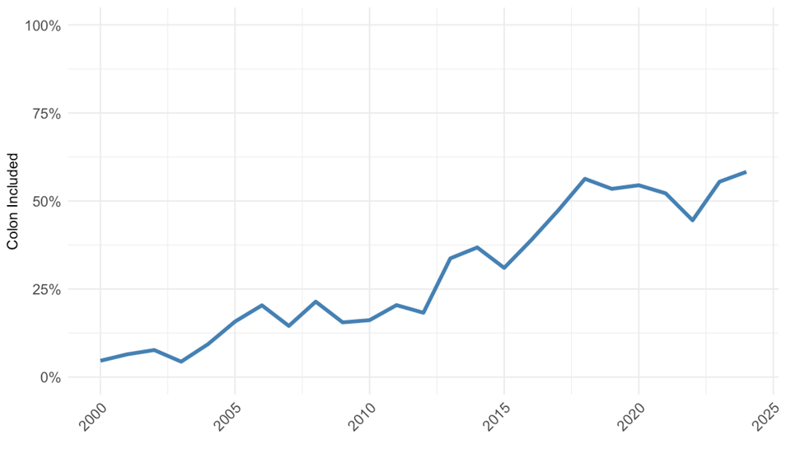
Colon Inclusion Over Time
Intestinal Transplant Registry Report © 2018

Slide 19

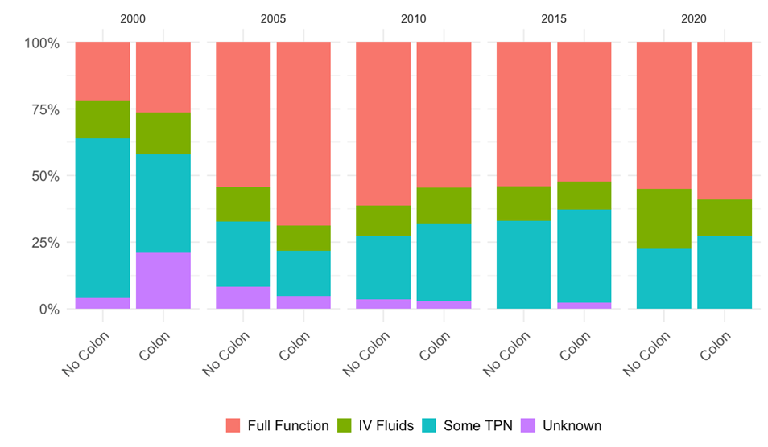
Intestinal Transplant Registry Report © 2018
Notes:
We are not necessarily observing a decrease in the need for IVFs, but in order to truly appreciate the potential advantage of a colon-inclusive graft we need to look more closely at renal function

Slide 20
Initial Hospitalization
Intestinal Transplant Registry Report © 2018

Slide 21
Initial Length of Stay
 | Pediatric | Adult
Median Initial LOS (days) | 53 (34, 90) | 41 (25, 70)
The initial length of stay has not changed significantly over time
Intestinal Transplant Registry Report © 2018

Slide 22
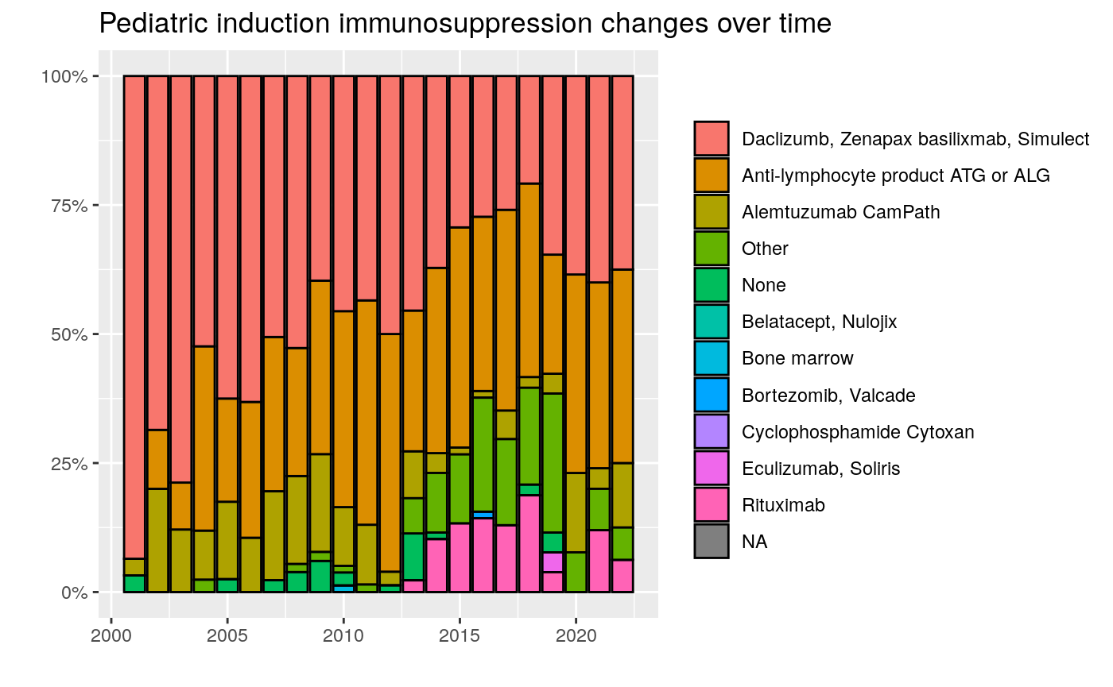
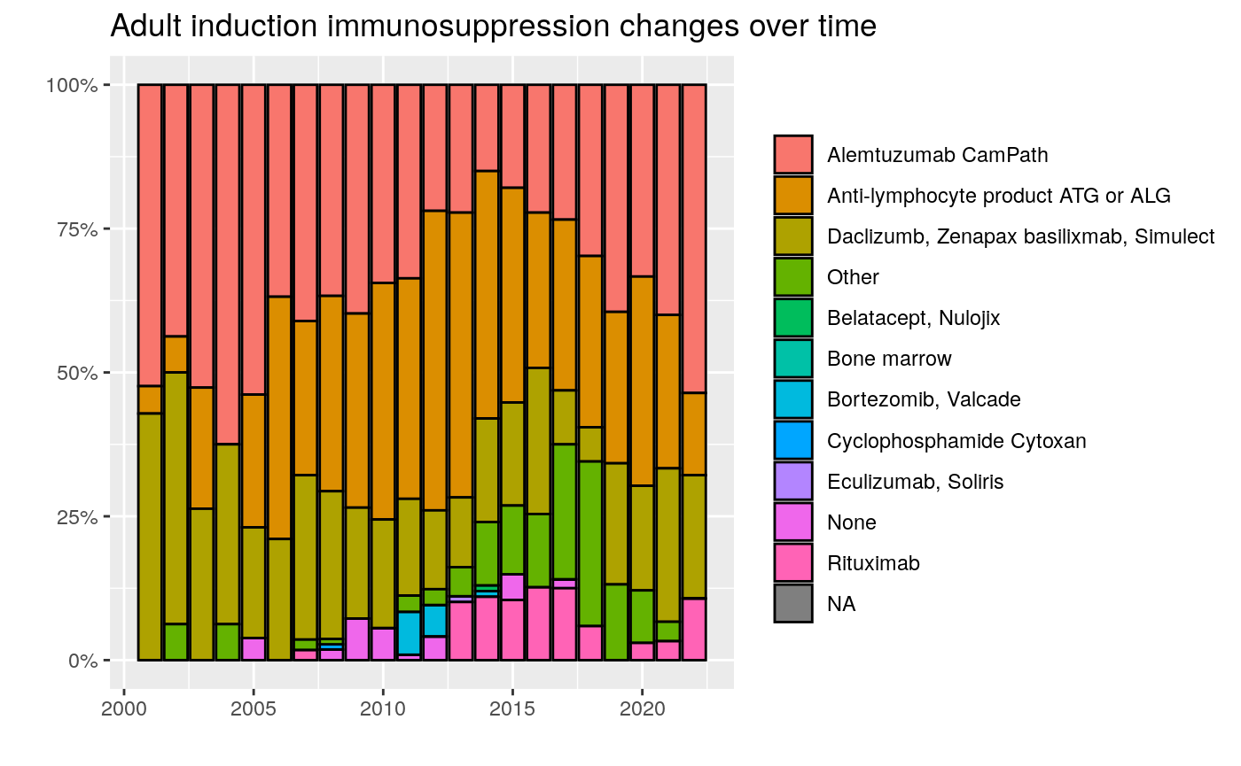
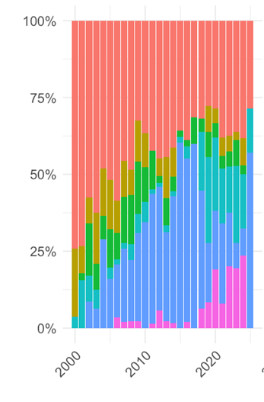

Induction Immunosuppression
Intestinal Transplant Registry Report © 2018

Slide 23
Rejection During Initial Hospitalization
 | No Rejection | Mild ACR | Mod-Severe ACR
Pediatric | 69% | 11% | 20%
Adult | 79% | 7% | 14%
Intestinal Transplant Registry Report © 2018

Slide 24
Long-Term Follow-Up
Intestinal Transplant Registry Report © 2018

Slide 25
At Last Follow-Up
Immunosuppression
 | Tac | CSa | MMF | Aza | Siro | Pred | Other
Ped+ Adults | 77% | 2% | 10% | 4% | 13% | 50% | 3%
Intestinal Transplant Registry Report © 2018

Slide 26
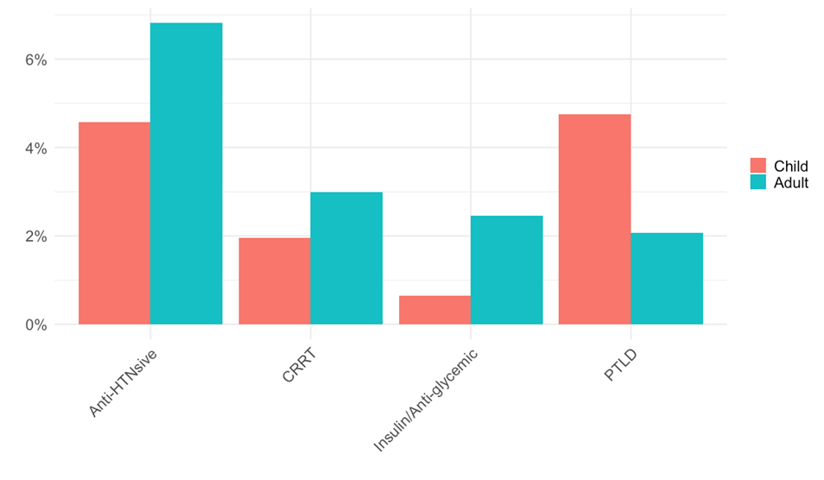
At Last Follow-Up
Complications
Intestinal Transplant Registry Report © 2018

Slide 27
Trends in Graft & Patient
Survival
Intestinal Transplant Registry Report © 2018

Slide 28
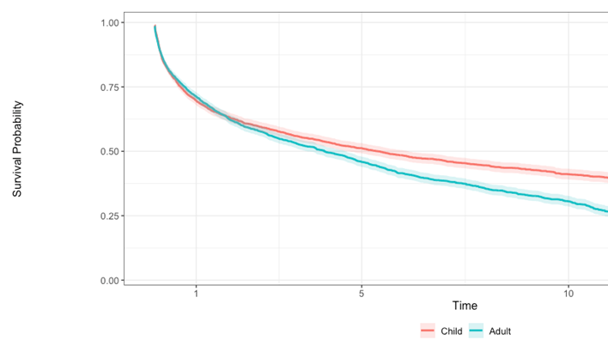
Overall Graft Survival (1985-2025)
Survival | 1- year | 5-year
Pediatric | 70% | 51%
Adult | 71% | 46%
Intestinal Transplant Registry Report © 2018
Notes:
Overall, 1‐year and 5‐year graft survival rates for children were 67% and 50%, respectively, and overall, one‐year and five‐year patient survival rates were 74% and 59% respectively; for adults the one year is slightly better than in children, but 5 year is not
but as we will see in the next slide significant improvement has been seen over time.

Slide 29
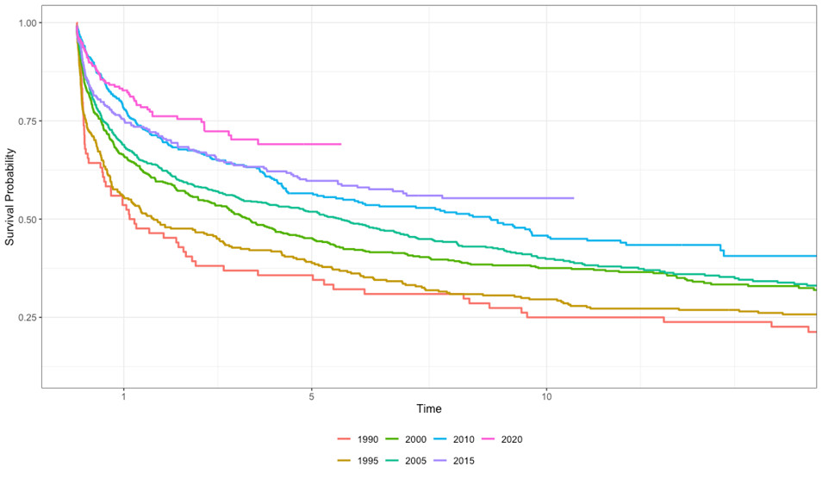
Pediatric Graft Survival by Era
Intestinal Transplant Registry Report © 2018
Notes:
One can appreciate that the differences in graft and patient survival by era occur mostly early on (within the first year), after which time the KM curves tend to follow the same slope. Another way this can be demonstrated is by looking at conditional survival

Slide 30
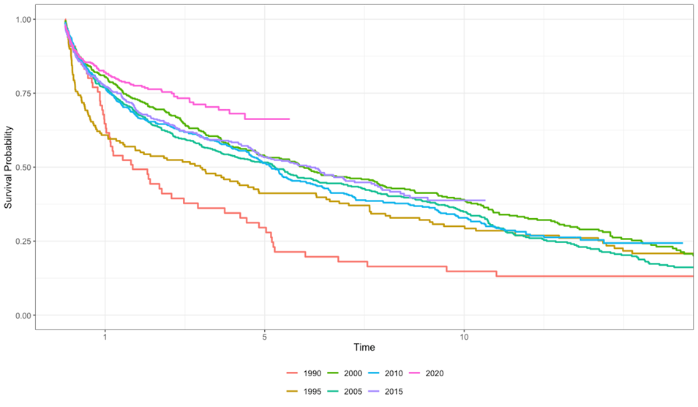
Adult Graft Survival by Era
Intestinal Transplant Registry Report © 2018
Notes:
One can appreciate that the differences in graft and patient survival by era occur mostly early on (within the first year), after which time the KM curves tend to follow the same slope. Another way this can be demonstrated is by looking at conditional survival

Slide 31
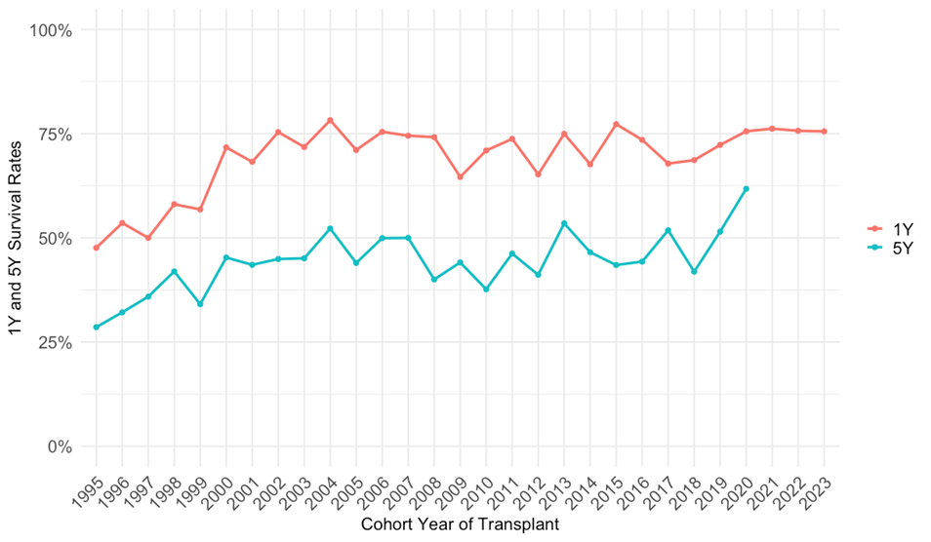
1 & 5 Year Graft Survival Over Time
Intestinal Transplant Registry Report © 2018
Notes:
One can appreciate that the differences in graft and patient survival by era occur mostly early on (within the first year), after which time the KM curves tend to follow the same slope. Another way this can be demonstrated is by looking at conditional survival

Slide 32
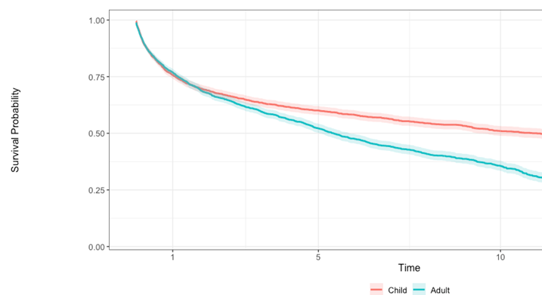
Overall Patient Survival (1985-2025)
Survival | 1- year | 5-year
Pediatric | 76% | 60%
Adult | 77% | 52%
Intestinal Transplant Registry Report © 2018
Notes:
Overall, 1‐year and 5‐year graft survival rates for children were 67% and 50%, respectively, and overall, one‐year and five‐year patient survival rates were 74% and 59% respectively; for adults the one year is slightly better than in children, but 5 year is not
but as we will see in the next slide significant improvement has been seen over time.

Slide 33
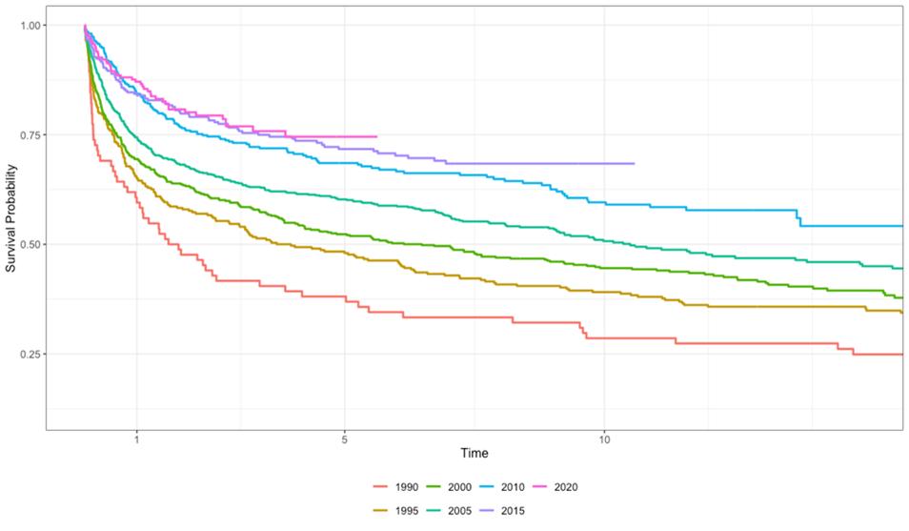
Pediatric Patient Survival by Era
Intestinal Transplant Registry Report © 2018
Notes:
One can appreciate that the differences in graft and patient survival by era occur mostly early on (within the first year), after which time the KM curves tend to follow the same slope. Another way this can be demonstrated is by looking at conditional survival

Slide 34

Adult Patient Survival by Era
Intestinal Transplant Registry Report © 2018
Notes:
One can appreciate that the differences in graft and patient survival by era occur mostly early on (within the first year), after which time the KM curves tend to follow the same slope. Another way this can be demonstrated is by looking at conditional survival

Slide 35
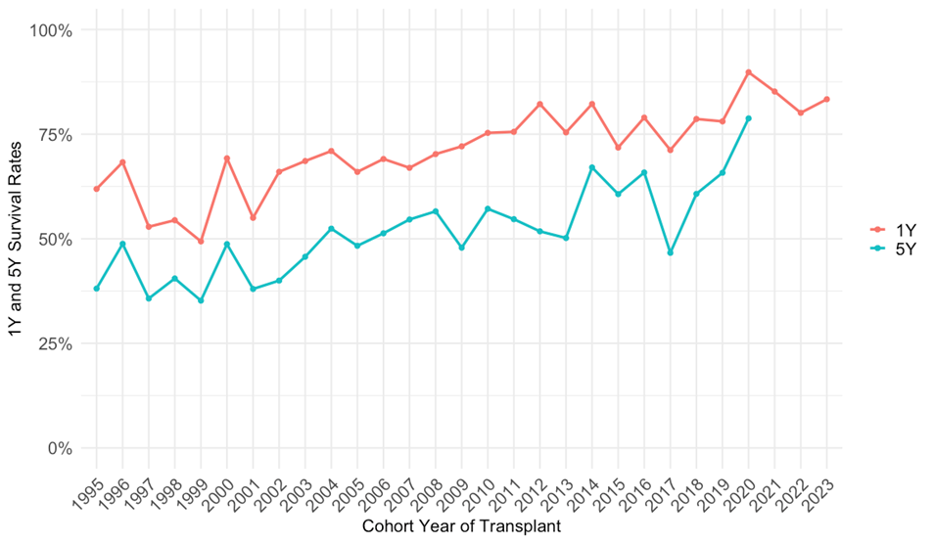
1 & 5 Year Patient Survival Over Time
Intestinal Transplant Registry Report © 2018
Notes:
One can appreciate that the differences in graft and patient survival by era occur mostly early on (within the first year), after which time the KM curves tend to follow the same slope. Another way this can be demonstrated is by looking at conditional survival

Slide 36
Causes of Death
(1985-2025)
Intestinal Transplant Registry Report © 2018
Notes:
Sepsis , Graft failure, MSOF = leading causes of death
Over the last three decades, the relative proportions of causes of death have not changed
Similarly, rejection remains the primary cause of graft loss; followed by technical complications

Slide 37
Challenges, Benefits &
The Future of IITR
Intestinal Transplant Registry Report © 2018
Notes:
Data entry; only 5 centers have entered data in the ITR since 2021 (DUAs); ask Eric about the map
SRTR imports
We are in the process of establishing a linkage between the UK NHS
Bowel Transplant registry and the IITR for UK centers. We've sent the
NHS the IITR data schematics and the NHS is working to export data
regularly to IITR.
The Terasaki institute synchronized the IITR with the SRTR a few years ago. I have
identified the following updates based on the updated SRTR data and improving upon
Terasaki's initial matching/syncing logic.
• Records added from SRTR
• 456 entirely new transplant baseline records added from SRTR
• 179 entirely new event records added from the SRTR
• Newly matched records between SRTR and IITR
• Transplant Center,
• Donor Type,
• the same or missing Gender,
• within one day of Transplant Date,
• within one day of Discharge Date,
• within one year or missing Recipient Age,
• within one cm or missing Recipient Height, within one kg or missing Recipient Weight,
and within one year or missing Donor Age.

Slide 38
IITR Challenges
Barriers to Data Entry:
  IRB & DUA Challenges
  Limited resources (unfunded registry)
Intestinal Transplant Registry Report © 2018
Notes:
TIME, COST, VALUE
Barriers to data entry include the low volume nature of ITx, IRB & DUA challenges, and lack of the ability for centers to commit resources to an unfunded registry. There are also a number of fields in the registry which have a high proportion of unfilled data which may pose an unnecessary burden to centers.

Slide 39
Recent IITR Publications
  Raghu V et al. Analysis of the intestinal transplant registry Pediatric Transplantation 2019
  Ceulemans L et al. Outcome after intestinal transplantation from living versus deceased donors: a propensity-matched cohort analysis of the IITR. Annals of Surgery 2023
  Pahl E et al. Toward and Ideal Outcome after Intestine Transplantation. Manuscript in preparation 2025
  Gondolesi G et al. IITR Analysis of Re-Transplant Patients. Data Analysis in progress 2025
  Oltean M et al. Analysis of Donor Variables and Intestinal Transplant Outcomes 2025
Intestinal Transplant Registry Report © 2018
Notes:
TOWARD AN IDEAL OUTCOME AFTER INTESTINE TRANSPLANTATION

Slide 40
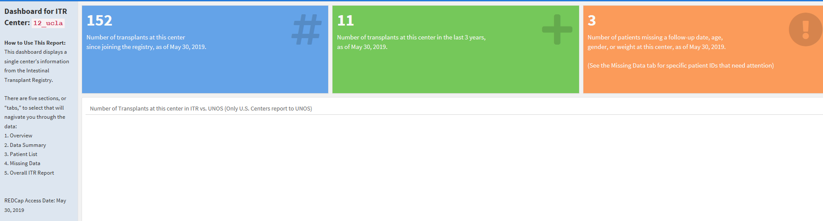
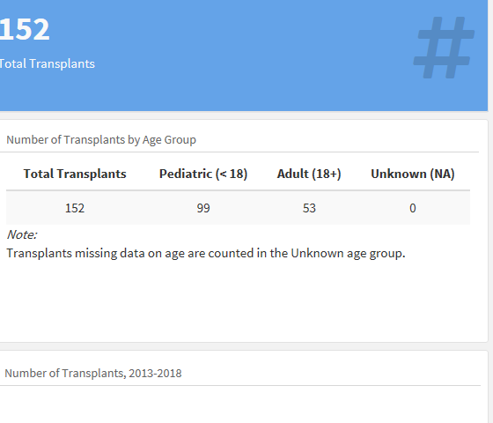
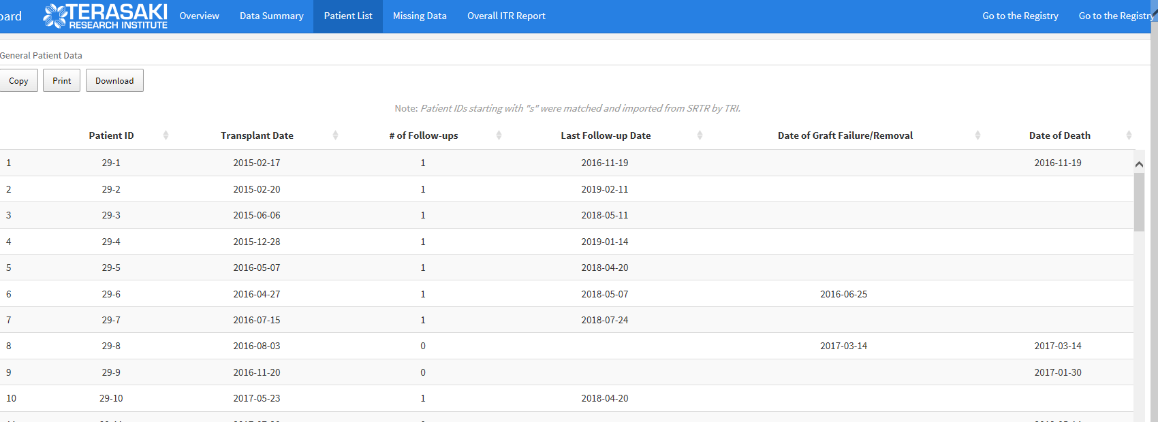
Individual Center Reports for IIRTA Members
Data Summary
Patient List
Value for benchmarking and QI
Intestinal Transplant Registry Report © 2018

Slide 41
Future IITR Opportunities
Promote the use of center dashboards (QI)
Streamline IRB & DUA process
Explore linkage between existing registries & the IITR through IIRTA Chapters
Encourage continuous data entry
Intestinal Transplant Registry Report © 2018

Slide 42
Future of the IITR
Utilize the IITR to address specific, targeted, contemporary knowledge deficits
IITR: Detailed, longitudinal, long-term outcomes and challenges
Intestinal Transplant Registry Report © 2018

Slide 43
Acknowledgements
IIRTA Council
IIRTA Scientific Committee
  Yaron Avitzur
  Christina Belza
  Masato Fujiki
  Taizo Hibi
  Tomoaki Kato
  George Mazariegos
  Mihai Oltean
  Eric Pahl
  Debra Sudan
  Robert Venick
  Rodrigo Vianna
  Joshua Weiner
  Paul Wales
  Yoyo Zhang
  Suzanne Landis
Intestinal Transplant Registry Report © 2018

